Slide 1
What’s Wrong With
American Education
And How Classical Schools Can Help Fix It

Slide 2
Fundamental Assumption
Ideas have consequences.
Only ideas have long and lasting consequences.¹
It’s important to advocate for ideas – not candidates.
Over the long term, changing who is elected won’t lead to sustainable improvements, only better ideas will.
¹Ideas Have Consequences is a book by Richard M. Weaver, published in 1948

Slide 3
Rules for Debate*
Principle of Humility
Remember that you don’t know everything, that you’ve been wrong before, and that you might learn something. The goal of a debate isn’t to win but to establish the truth. You can’t lose. If you are proven wrong, you win by knowing the truth.
Judgment of Charity
Assume the best and most honorable motives on the part of your opponent.
*http://www.newhopefairfax.org/files/Coffin%20Argumentation-20%20principles.pdf

Slide 4
Rules for Debate*
Gerstner’s Law
Do not debate a point of contention until you can state your opponent’s position to his or her satisfaction.
Seek Common Ground
Establish common ground as a starting point for the discussion.
*http://www.newhopefairfax.org/files/Coffin%20Argumentation-20%20principles.pdf

Slide 5
Common Ground
No one is against public or private education
We all want all schools to succeed and for students to reach their potential no matter where they attend.
No one is against teachers
We all want teachers to succeed and do their best possible work.

Slide 6
Common Ground
All topics are fair game but never personal
It may feel awkward, but we have to give ourselves permission to talk about teacher quality and school quality. Most people involved are trying their hardest, but it’s still acceptable to debate their results.
The debate is not about values.
Supporting or opposing more funding for education or advocating a change in policy doesn’t mean you don’t value education. We’re debating how to make it better.

Slide 7
What’s Wrong?
Big Idea #1
Education schools often promote well-intended but misleading myths about teaching and learning.
Big Idea #2
Teacher certification, which is based on education schools’ well-intended but misleading ideas, contributes little to teachers’ effectiveness, and perpetuates the teacher shortage in some subjects.
Big Idea #3
Administrators are influenced by the prevailing ideas in education schools. As a result, they often promote ineffective academic programs and management changes.

Slide 8
What’s Wrong?
Big Idea #4
Parents and other “outsiders” often have different views of what constitutes a sound education, but have little influence on the content and implementation in the public schools.
Big Idea #5
School choice empowers parents to select schools that reflect what they want for their children, and provides teachers with more options for their work environment.
Big Idea #6
School choice is necessary but not sufficient to improve public education. Education must also transform itself from a belief-based profession into an evidence-based profession.

Slide 9
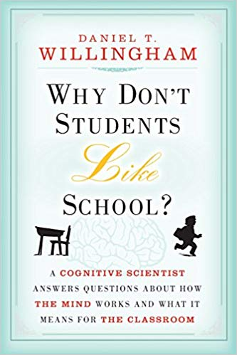
Teaching and Learning Myths
Big Idea #1
Education schools often promote well-intended but misleading myths about teaching and learning.
These books accurately explain the myths, and are the sources for this section.

Slide 10
Teaching and Learning Myths
Myth | Reality
Learning Styles | Forty years of research have not found evidence that there are visual, kinesthetic, and auditory learners or that teachers can achieve better results by trying appeal to “learning styles”.
Multiple Intelligences | Mainstream psychologists have little regard for the idea that there are seven different kinds of intelligence (or what most would call talents), and even the theory’s originator said educators have taken it too far.
Rote Memorization Is Bad | This misleading phrase is employed to argue against any sort of factual knowledge, and used to defend curricula that lack important content. Some rote memorization is required to learn rudimentary knowledge, such as the letters of the alphabet.
The Eclectic Teacher | The idea that teachers should string together lessons drawn from multiple sources in an effort to customize learning to students. Large scale research suggests that well-designed, scientifically validated curricula that use a consistent approach for all students with relatively minor modifications can achieve consistently positive results.

Slide 11
Teaching and Learning Myths
Myth | Reality
Balanced Literacy Is Best | Most schools believe that “balanced literacy” is the best way to teach reading. However, the National Reading Panel reviewed over 110,000 studies and found that scientifically-based reading instruction that systematically and explicitly teaches phonemic awareness, phonics, vocabulary, fluency, and comprehension works best.
Learning By Doing | The idea that students learn best or more “authentically” by participating in hands-on projects. Project Follow Through, the largest education study in human history found that the Direct Instruction program, which emphasized teacher-led instruction, produced the best results, and many other studies have found that teacher-led instruction equally or more effective than learning by doing.
Disability and Poverty Explain Poor Results | The idea that students’ learning disabilities, poverty, or families explain their lack of achievement. However, 95% of learning disabilities are mild. Personal circumstances can be mitigated through high expectations, solid teaching, and student effort.

Slide 12
Teaching and Learning Myths
“What ideology could possibly trump good reading instruction? It is a fierce ideological obsession that cuts across all facets of teachers’ preparation: the belief that every student is so unique that the best teaching practices cannot be applied.
As one education professor put it to me, ‘Even if I knew some practice would be effective 80 percent of the time, I don’t include it in my course. I don’t want it to color the choices my teachers should be able to make using their own judgment.’ ”*
Kate Walsh, President, National Council for Teacher Quality
*https://www.nctq.org/blog/An-open-letter-to-all-who-care-about-making-sure-every-child-in-America-learns-to-read

Slide 13
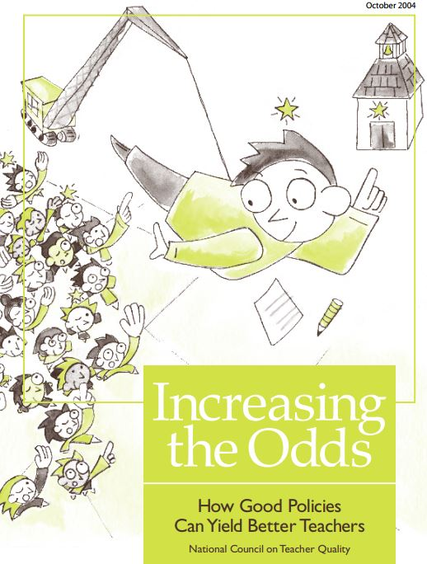
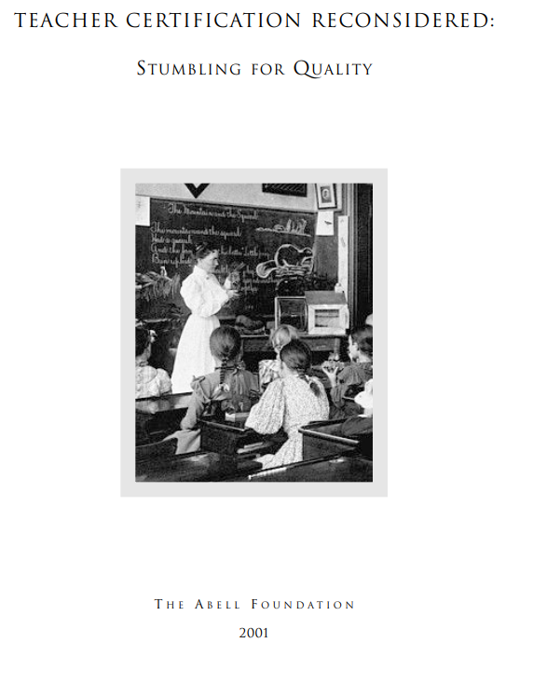
Teacher Certification
Big Idea #2
Teacher certification, which is based on education schools’ well-intended but misleading ideas, contributes little to teachers’ effectiveness, and perpetuates the teacher shortage in some subjects.
These reports and www.nctq.org are the sources for this section.

Slide 14
Teacher Certification
Teacher Quality and Effectiveness
“Even if all of the research on certification is considered uncritically, at best the conclusion is that the traditional certification process may only add some marginal value.”
87% of education schools fail to prepare teachers to teach elementary math.
85% of education schools fail to prepare teachers in scientifically-based reading instruction.
Teachers are disproportionately in the bottom third of college graduates.
High-achieving graduates without formal education training working low-income schools produced “higher test scores than the other teachers in their schools—not just other novice teachers or uncertified teachers, but also veterans and certified teachers”*
*https://files.eric.ed.gov/fulltext/ED496298.pdf

Slide 15
Teacher Certification
Teacher Shortage
The time and expense of traditional certification discourages many applicants from considering joining the profession.
Maryland’s alternative certification intended to attract career changers has only produced 1% of our teachers. In contrast, New Jersey’s alternative certification produces 20-25% of its teachers.
Non-traditional candidates are often more diverse and bring stronger academic backgrounds than traditional candidates.
Being certified doesn’t mean a teacher is effective, so why limit the applicant pool to certified candidates?

Slide 16
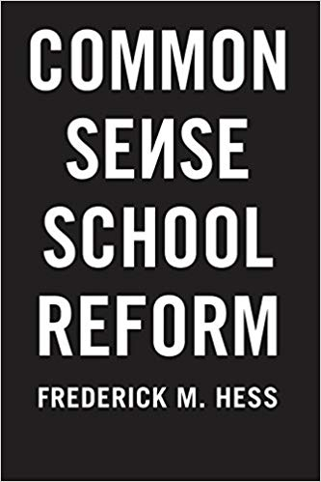
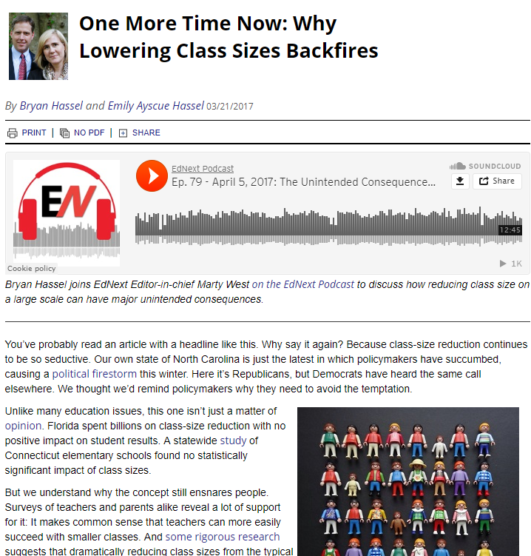
School Administration
Big Idea #3
Administrators are influenced by the prevailing ideas in education schools. As a result, they often promote ineffective academic programs and ineffective management changes.
These books and reports are the sources for this section.

Slide 17
School Administration
Ineffective Academic Programs
In other fields, there is a consensus about what works. Doctors aren’t debating how to treat common maladies.
Every 5-7 years or so educators embark upon a “new” testing or teaching approach, claiming what they did before wasn’t adequate. These approaches are often the same thing with a new name.
Educators have engaged in “reading wars” and “math wars” for decades, relying on philosophical beliefs and personal experience rather than evidence to pick programs. TERC Math, “Balanced Literacy”, “21st Century Skills” and using more technology are ineffective approaches our schools have chosen.

Slide 18
School Administration
Ineffective Structural Changes
Class Size Reductions -- There’s little evidence it helps students aside from kindergarten. It increases construction and personnel costs, and reduces teacher quality as schools reach deeper into the applicant pool. Hiring more teachers makes it harder to raise salaries.*
Increasing Salaries -- Across-the-board salary percentage increases largely benefit those at the top of the salary scale, who are the least likely to leave. Uniform salary scales also tend to overpay in easy-to-staff positions (art and physical education) and underpay hard-to-staff positions (math, science, and special education), which leads to teacher shortages in some positions. There is not an overall teacher shortage. Education schools produce more teachers than districts hire every year.**
*https://www.educationnext.org/one-time-now-lowering-class-sizes-backfires/
**https://www.nctq.org/blog/The-Ghost-of-Teacher-Shortages-Past…

Slide 19
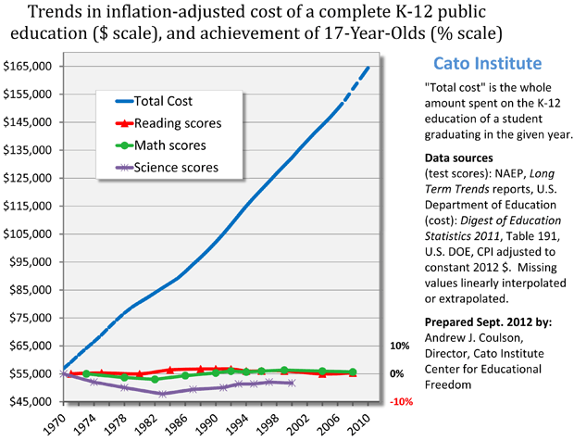
School Administration
Ineffective Structural Changes
Spending More Money -- Research has not found a correlation between student achievement and spending.

Slide 20
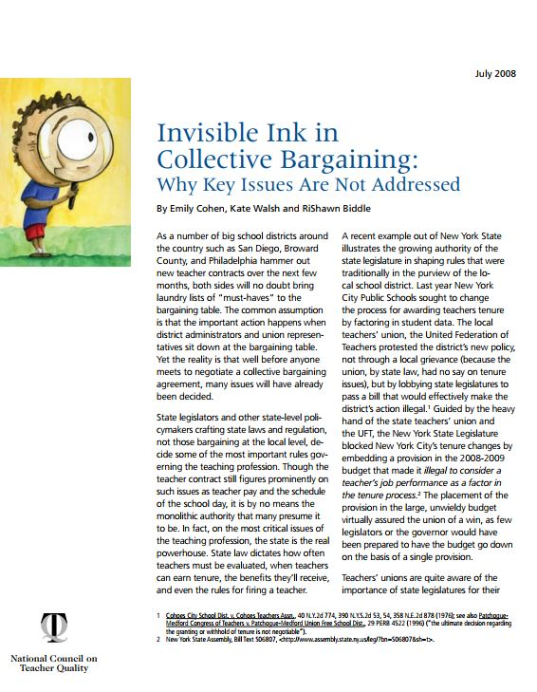
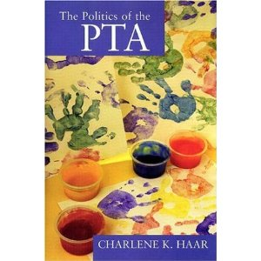
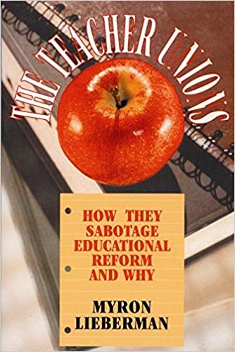
Parents Are Outsiders
Big Idea #4
Parents and other “outsiders” often have different views of what constitutes a sound education, but have little influence on the content and implementation in the public schools.
These books and reports are the sources for this section.

Slide 21
Parents Are Outsiders
Unions
The teachers union is the strongest influence in most local elections. Their primary focus is on obtaining additional benefits for teachers, not students.
Teacher unions are the largest political force nationally, and typically send the largest delegation to the Democratic National Convention (with the exception of the state of California)
Unions have fought against improvements like more choices for parents, greater fiscal responsibility, removing ineffective teachers. Teacher contracts and state laws unions advocate for often give principals little leeway in improving how schools are run.

Slide 22
Parents Are Outsiders
Professional Organizations
National Council of Teachers of Mathematics (NCTM) -- Have historically advocated for placing less emphasis on math content, though they have reversed course somewhat in recent years.
National Council of Teachers of English (NCTE) -- Have taken a position favoring “balanced literacy” instead of scientifically-based reading instruction.
*http://www2.ncte.org/statement/ebonics/

Slide 23
Parents Are Outsiders
Parent Organizations
PTA -- Supports the teachers’ union agenda. Their membership has declined and given rise to Parent Teacher Organizations (or PTOs), which have more freedom to advocate for changes and can spend more of their own money on their local school.
“We want people who are committed to this agenda, and if they’re not, that’s fine.
Go be a PTO and have a nice life.”*
PTA Director of Public Relations
*https://books.google.com/books?id=gXj95Q8uJwoC&pg=PA12&lpg=PA12&dq=pta+%22have+a+nice+life%22&source=bl&ots=rCxVDVpYsF&sig=puWuz22p0_env9FdsESvviP3lxM&hl=en&sa=X&ved=2ahUKEwjMwJ3D5ujfAhVtc98KHfJBB18Q6AEwAHoECAkQAQ#v=onepage&q=pta%20%22have%20a%20nice%20life%22&f=false

Slide 24
Parents Are Outsiders
Teacher Attitudes vs. Parent Attitudes
Academics -- Parents tend to focus on academic results, but teachers tend to be more concerned about “social justice” and “equity”.
Spending -- Once informed about the current spending levels, parents are less likely to favor more spending than teachers.*
School Choice -- Parents favor school choice more than educators do. (In many other countries school choice, including vouchers, is considered the norm and widely supported.)
Attitude of Authority-- The phrase “trust us, we are the professional educators” is used against parents to dismiss their concerns, even when parents bring solid evidence that educators are mistaken.
*https://www.educationnext.org/do-teachers-and-parents-want-the-same-things/
https://www.educationnext.org/2018-ednext-poll-interactive/

Slide 25
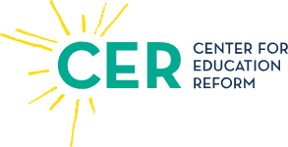
School Choice
Big Idea #5
School choice empowers parents to pick schools that reflect what they want for their children, and provides teachers with more options for their work environment.
These organizations are the sources for this section.

Slide 26
School Choice
School Choice
Type | What Is it?
Charter School | A public school with freedom to implement a different instructional and management approach. The funding that would have been spent on each child in the regular public schools shifts to the charter school.
Voucher | A coupon from the government that is accepted as payment for tuition and materials at participating private schools.
Tax Credit | Parents can claim a deduction on their taxes for expenses associated with private or homeschool expenses.
Home School | Parents teach their children at home, often with oversight by the local school system.
Educational Savings Account (ESA) | A limited use card (like food stamps) that allows parents to pay for education expenses, including tutoring, and are not limited to school institution expenses as vouchers are.

Slide 27
School Choice
Maryland’s Low Charter Law Rankings
NACSA -- 3rd Worst In Nation
EdReform.com -- 2nd Worst In Nation
National Alliance for Public Charters -- Worst In Nation
Maryland Has A Limited Voucher Program
With a budget of only $5 million statewide, few students benefit.
Teachers unions opposed this modest program for poor kids.

Slide 28
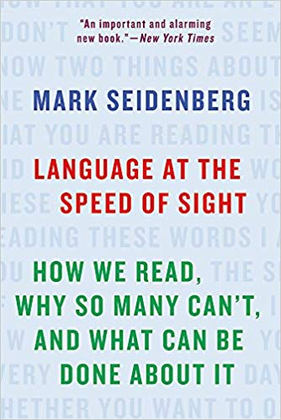
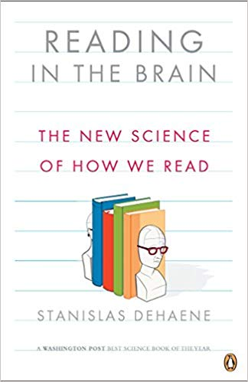
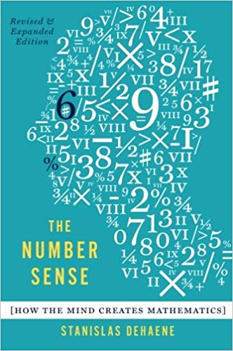
School Administrators
Big Idea #6
School choice is necessary but not sufficient to improve public education. Education must also transform itself from a belief-based profession into an evidence-based profession.
These books are the sources for this section.

Slide 29
Transforming the Profession
Making Teaching Evidence-Based
“Balanced literacy was a way to defuse the wars over reading. It succeeded in keeping the science at bay, and it allowed things to continue as before.
[T]he reading wars are over, and science lost.
In fact, confronted with data that contradict deeply held beliefs, instead of bringing people closer together, it can have the paradoxical effects of entrenching them further.”
Dr. Mark Seidenberg*
*https://www.apmreports.org/story/2018/09/10/hard-words-why-american-kids-arent-being-taught-to-read

Slide 30
How Classical Schools Help
Classical Schools = Restoring the Ruins
Elements of the classical approach (such as having seven subjects) haven’t completely disappeared in our public schools, but eroded to the point where the strengths of a classical education are no longer a part of students’ education.
Prior to the late 1800’s most American students received something very close to a classical education, but this declined due to John Dewey and other educational theorists who started the earliest departments of education that granted teaching credentials, and taught the first generations of teachers less effective methods of instruction, which persist today.

Slide 31
How Classical Schools Help
What is a Classical education?
It is NOT about being “old fashioned”.
It is NOT a teaching technique per se.
It is education that follows the Trivium.

Slide 32
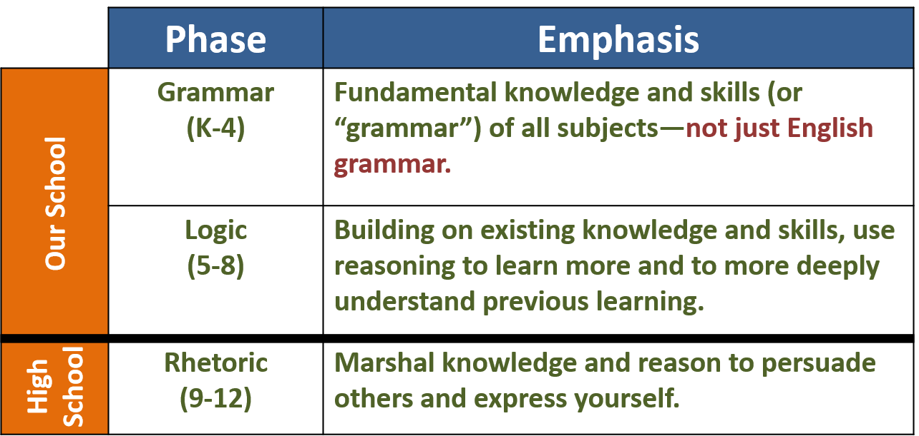
How Classical Schools Help
What is the Trivium?
It is a way of organizing the curriculum that roughly corresponds to students’ development.

Slide 33
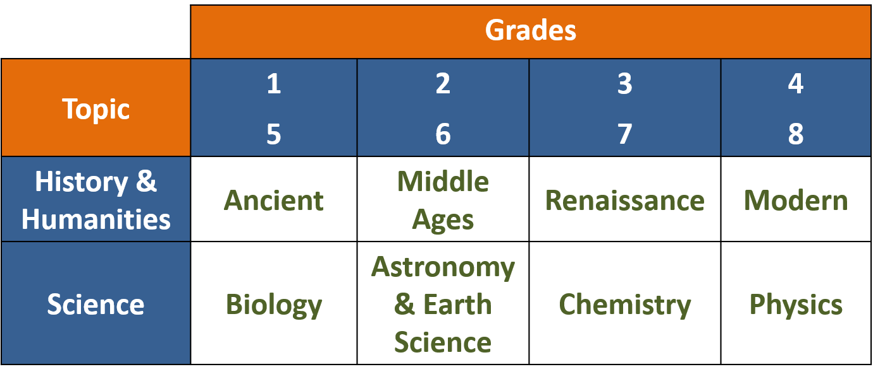
How Classical Schools Help
Classical Curriculum = Coherent Integration

Slide 34
How Classical Schools Help
What is a charter school?
It is NOT a religious school.
It does NOT charge tuition.
It does NOT screen applicants in any way.
It is a free, secular public school that signs a contract or “charter” with the local Board of Education and is given (in nearly everywhere except Maryland) freedom to operate the school independently in exchange for getting results.

Slide 35
How Classical Schools Help
Classical Charters vs. Regular Public School
Area | Typical Public School | Classical Charter Schools
Curriculum Structure | Based on student and teacher interests Gaps and repetitions from grade to grade Isn’t coherent. | Based on history Taught chronologically in a pre-defined sequence Coherent and thorough.
Content | “Exposure” to many topics is valued over mastery of a few Years of “exposure” doesn’t lead to mastery | It it’s worth teaching, it’s worth teaching to mastery. Students master the material that is taught each year so they are prepared for next year.
Instructional Techniques | Typically changes every 5-7 years to another progressive idea with little track record. Little research backing and poor results | Time-tested instructional techniques that stay the same Supported by decades of research with demonstrated results.
Administration | Bureaucratic rules limit staff freedom and student success Spend more money and achieve mediocre results at best | Greater staff freedom and student success Spend less money and achieve better results

Slide 36
How Classical Schools Help
The True, The Good, The Beautiful
Classical schools (both charter and private), focus on teaching students about the true, the good, and the beautiful in life, not state mandated tests.
“At its best, general education is about the unity of knowledge, not
about distributed knowledge. Not about spreading courses around, but
about making connections between different ideas. Not about the freedom to combine random ingredients, but about joining an ancient lineage of the learned and wise. And it has a goal, too: producing an enlightened, self- reliant citizenry, pluralistic and diverse but united by democratic values.” ¹
“Education, true education, should liberate; it should cultivate the
genuinely free man, the man of moral judgment, of intellectual
integrity; it should give us the power to see the other side; it should impart nobility of purpose and kindliness of spirit.” ²
¹https://www.goacta.org/publications/downloads/WhatWillTheyLearnFinal.pdf
² http://www.edexcellence.net/detail/news.cfm?news_id=372

Slide 37
Conclusion
What Can Be Done?
Parents, let’s talk!

